Slide 1

332:479 Concepts in VLSI
Design
Lecture 17
Datapath Functional Units
David Harris
Harvey Mudd College
Spring 2004

Slide 2
Outline
0 and 1 Detectors
Comparators
Shifters
Multi-input Adders
Multipliers
Summary
Material from: CMOS VLSI Design,
by Weste and Harris, Addison-Wesley, 2005

Slide 3
Comparators
0’s detector: A = 00…000
1’s detector: A = 11…111
Equality comparator: A = B
Magnitude comparator: A < B

Slide 4
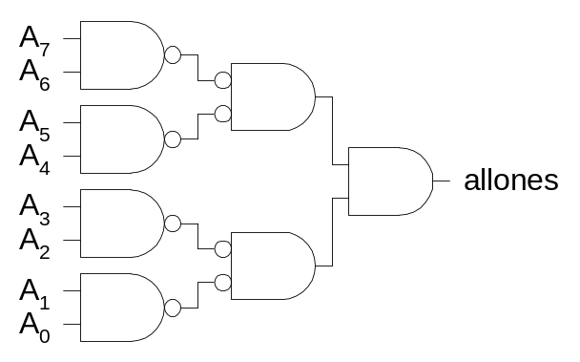
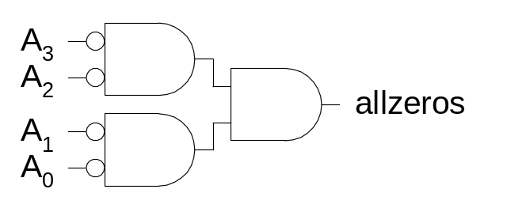
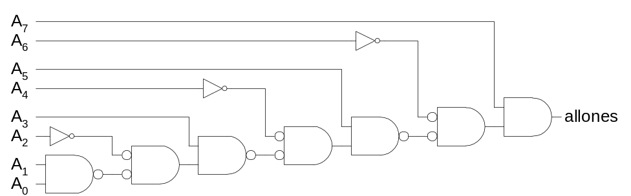
1’s & 0’s Detectors
1’s detector: N-input AND gate
0’s detector: NOTs + 1’s detector (N-input NOR)

Slide 5
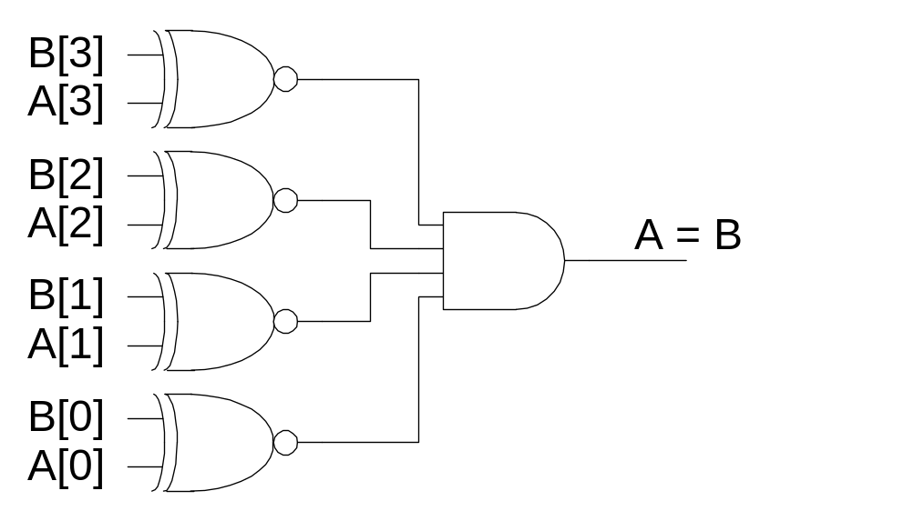
Equality Comparator
Check if each bit is equal (XNOR, aka equality gate)
1’s detect on bitwise equality

Slide 6
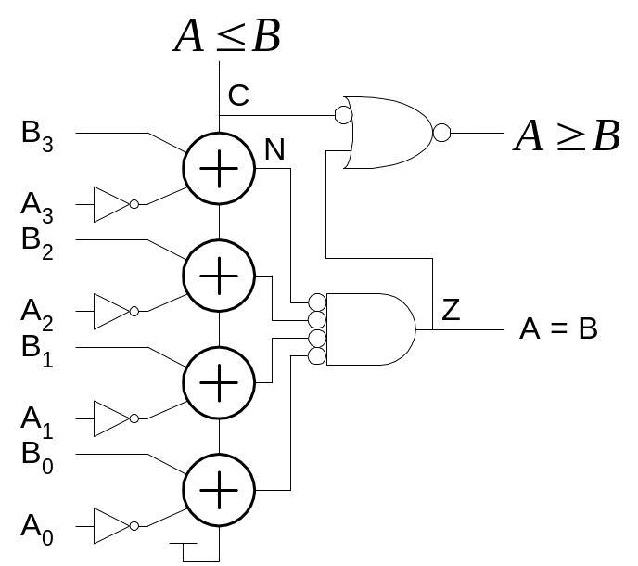
Magnitude Comparator
Compute B-A and look at sign
B-A = B + ~A + 1
For unsigned numbers, carry out is sign bit

Slide 7
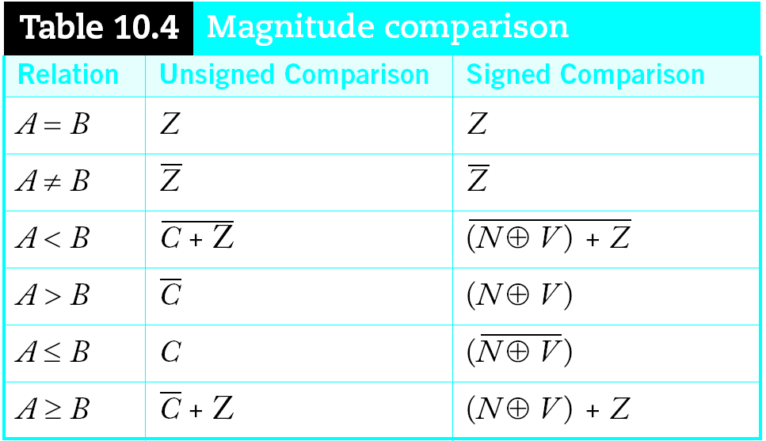
Signed vs. Unsigned
For signed numbers, comparison is harder
  C: carry out
  Z: zero (all bits of A-B are 0)
  N: negative (MSB of result)
  V: overflow (inputs had different signs, output sign ≠ B)

Slide 8
Shifters
Logical Shift:
  Shifts number left or right and fills with 0’s
    1011 LSR 1 = ____ 1011 LSL1 = ____
Arithmetic Shift:
  Shifts number left or right. Rt shift sign extends
    1011 ASR1 = ____ 1011 ASL1 = ____
Rotate:
  Shifts number left or right and fills with lost bits
    1011 ROR1 = ____ 1011 ROL1 = ____

Slide 9
Shifters
Logical Shift:
  Shifts number left or right and fills with 0’s
    1011 LSR 1 = 0101 1011 LSL1 = 0110
Arithmetic Shift:
  Shifts number left or right. Rt shift sign extends
    1011 ASR1 = 1101 1011 ASL1 = 0110
Rotate:
  Shifts number left or right and fills with lost bits
    1011 ROR1 = 1101 1011 ROL1 = 0111

Slide 10
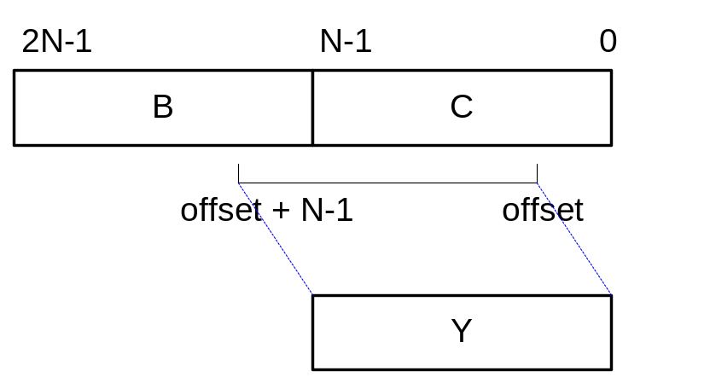
Funnel Shifter
A funnel shifter can do all six types of shifts
Selects N-bit field Y from 2N-bit input
  Shift by k bits (0 ≤ k < N)

Slide 11
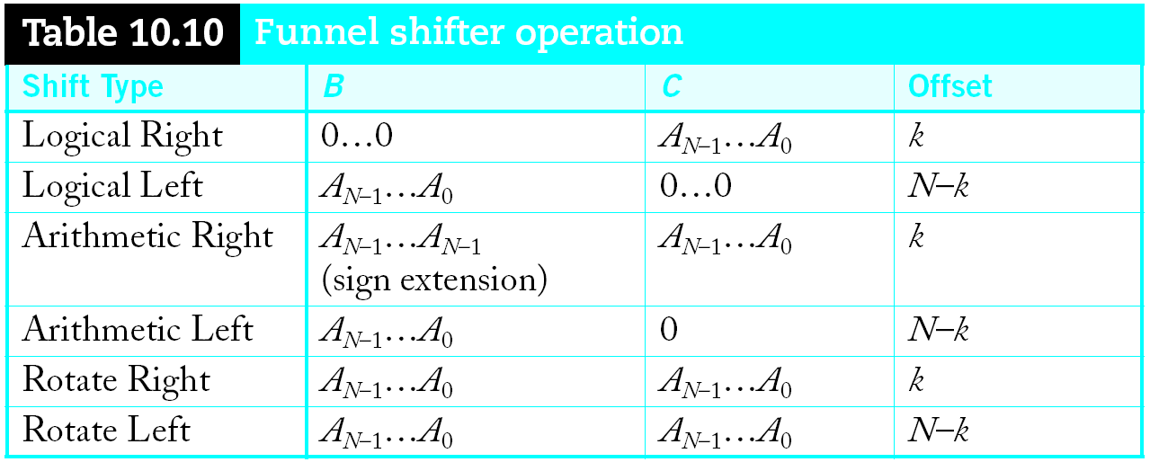
Funnel Shifter Operation
Computing N-k requires an adder

Slide 12
Funnel Shifter Operation
Computing N-k requires an adder

Slide 13
Funnel Shifter Operation
Computing N-k requires an adder

Slide 14
Funnel Shifter Operation
Computing N-k requires an adder

Slide 15
Funnel Shifter Operation
Computing N-k requires an adder

Slide 16
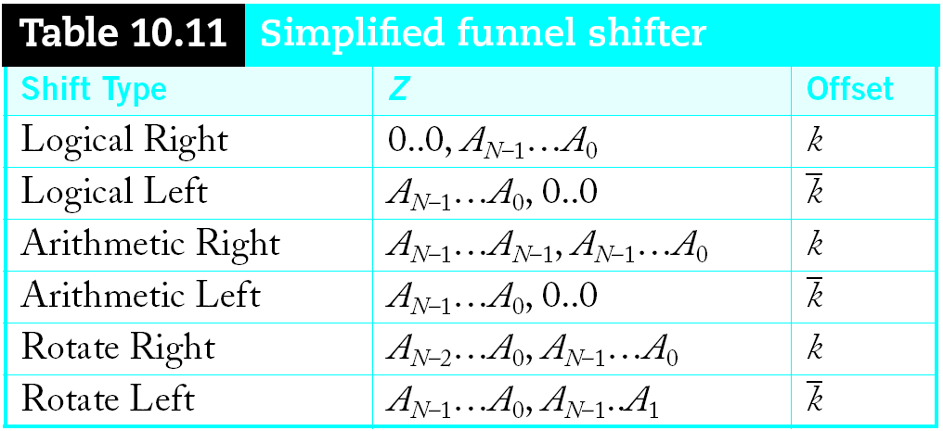
Simplified Funnel Shifter
Optimize down to 2N-1 bit input

Slide 17
Simplified Funnel Shifter
Optimize down to 2N-1 bit input

Slide 18
Simplified Funnel Shifter
Optimize down to 2N-1 bit input

Slide 19
Simplified Funnel Shifter
Optimize down to 2N-1 bit input

Slide 20
Simplified Funnel Shifter
Optimize down to 2N-1 bit input

Slide 21
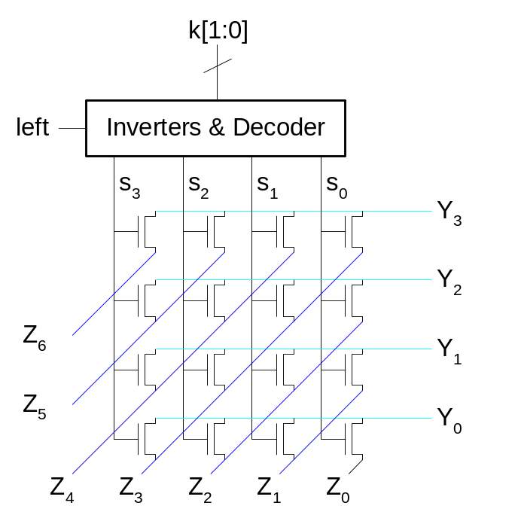
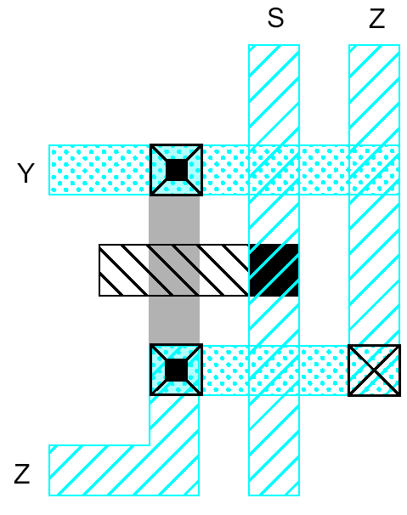
Funnel Shifter Design 1
N N-input multiplexers
  Use 1-of-N hot select signals for shift amount
  nMOS pass transistor design (V_{t} drops!)

Slide 22
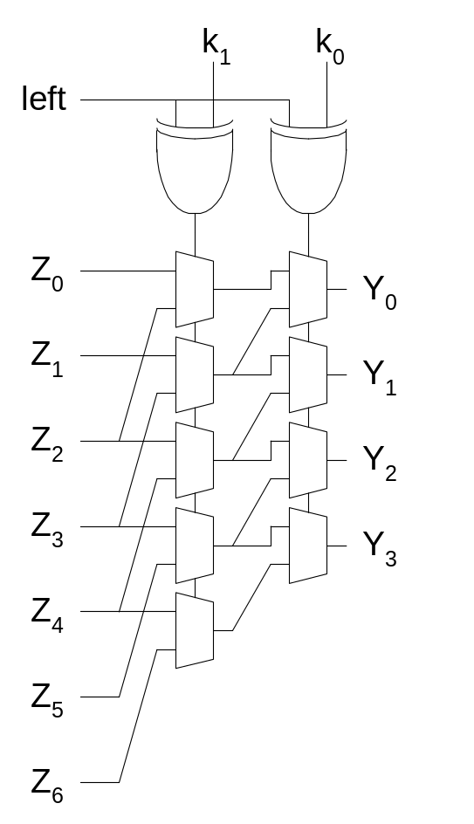
Funnel Shifter Design 2
Log N stages of 2-input muxes
  No select decoding needed

Slide 23
Multi-Input Adders
Suppose we want to add k N-bit words
  Ex: 0001 + 0111 + 1101 + 0010 = _____

Slide 24
Multi-Input Adders
Suppose we want to add k N-bit words
  Ex: 0001 + 0111 + 1101 + 0010 = 10111

Slide 25
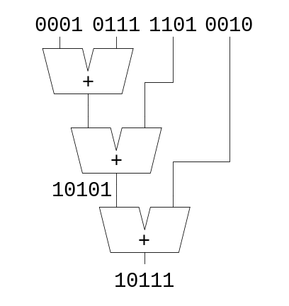
Multi-Input Adders
Suppose we want to add k N-bit words
  Ex: 0001 + 0111 + 1101 + 0010 = 10111
Straightforward solution: k-1 N-input CPAs
  Large and slow

Slide 26
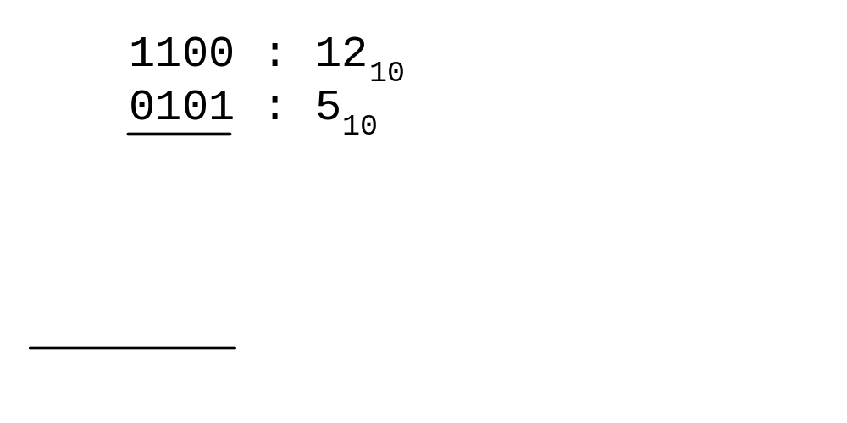
Multiplication
Example:

Slide 27
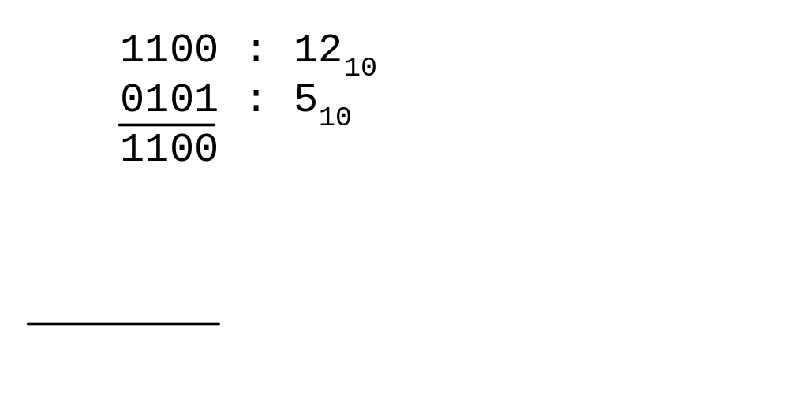
Multiplication
Example:

Slide 28
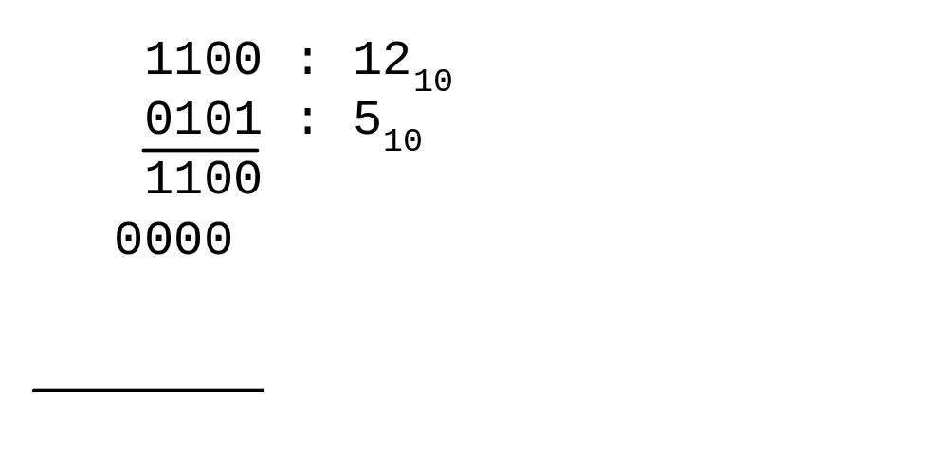
Multiplication
Example:

Slide 29
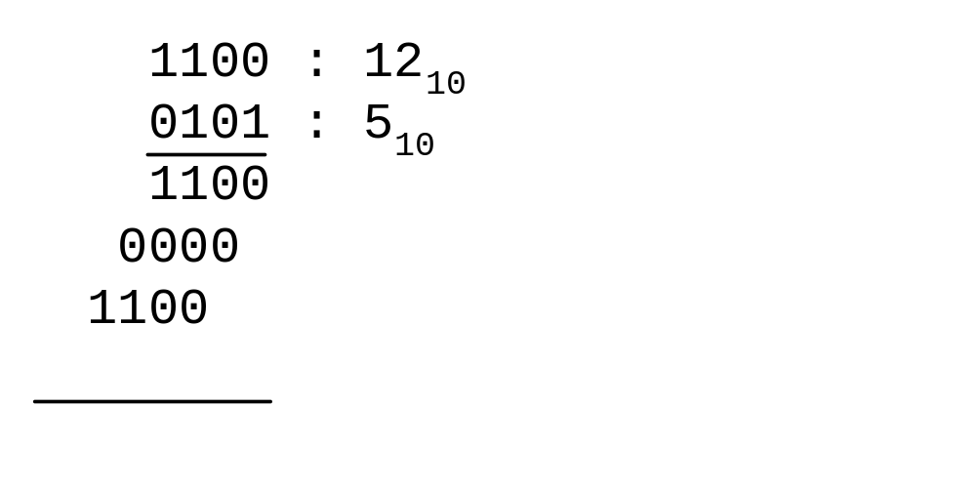
Multiplication
Example:

Slide 30
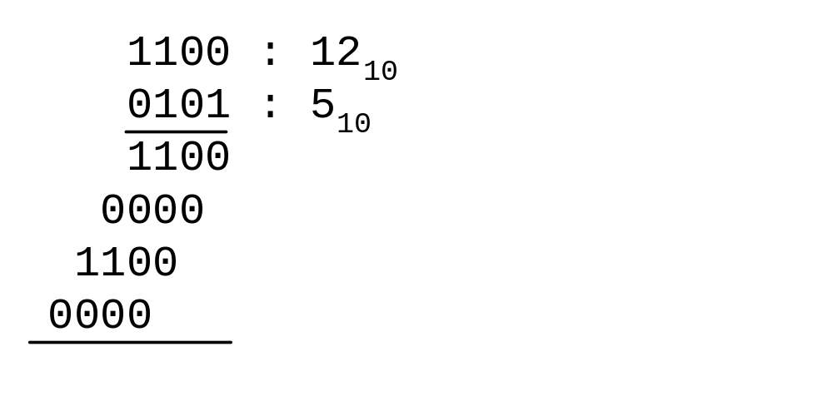
Multiplication
Example:

Slide 31
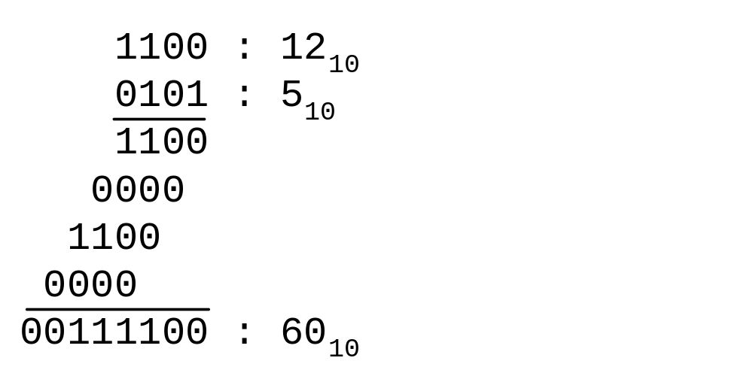
Multiplication
Example:

Slide 32
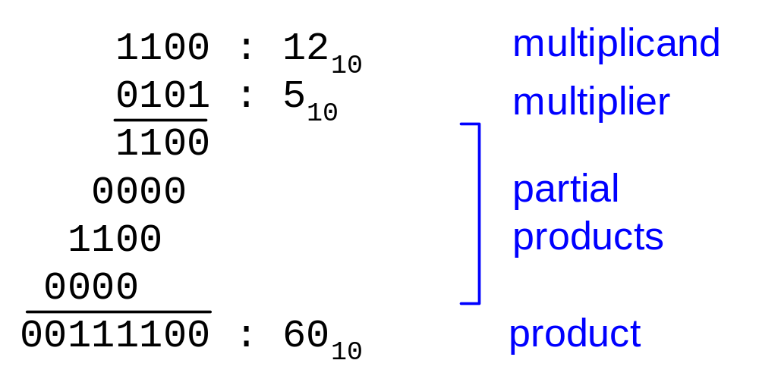
Multiplication
Example:
M x N-bit multiplication
  Produce N M-bit partial products
  Sum these to produce M+N-bit product

Slide 33
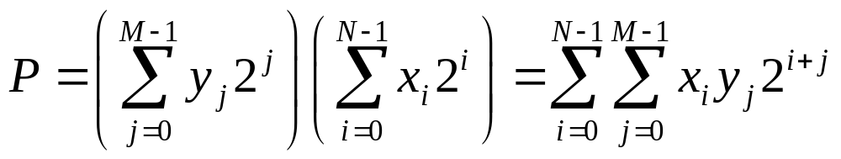
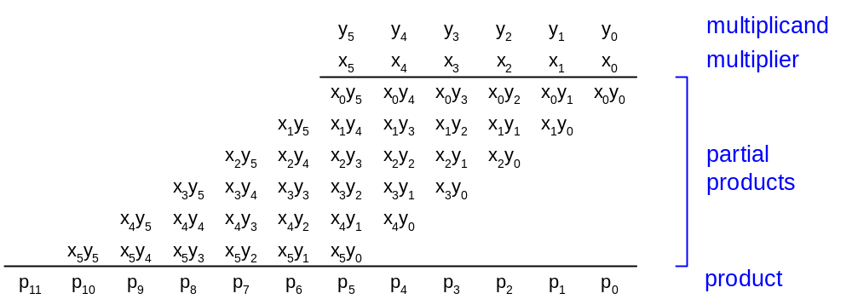
General Form
Multiplicand: Y = (y_{M-1}, y_{M-2}, …, y₁, y₀)
Multiplier: X = (x_{N-1}, x_{N-2}, …, x₁, x₀)
Product:

Slide 34
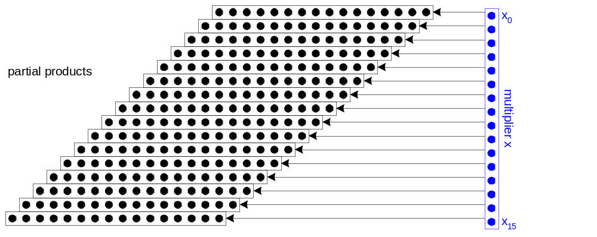
Dot Diagram
Each dot represents a bit

Slide 35
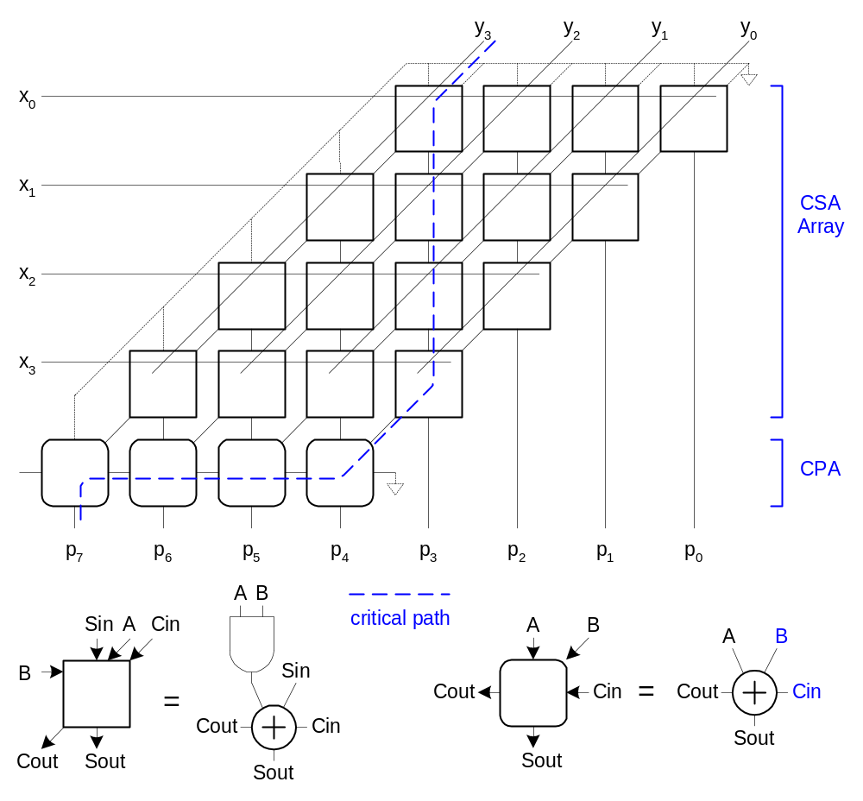
Array Multiplier

Slide 36
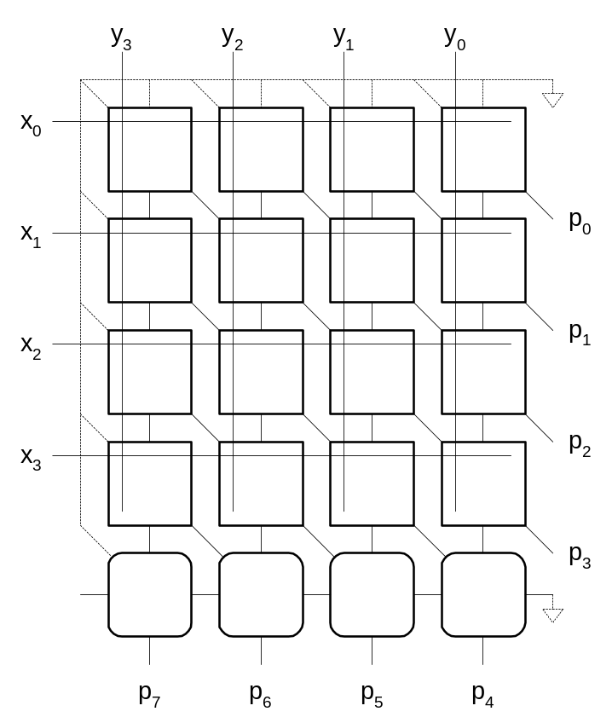
Rectangular Array
Squash array to fit rectangular floorplan

Slide 37
Summary
0 and 1 Detectors
Comparators
Shifters
Multi-input Adders
Multipliers

